Slide 1
Unit ‘4’ Hashing and Message Digest
Prepared by: Abhishek Dewan Lecturer Cryptography Trinity International College

Slide 2
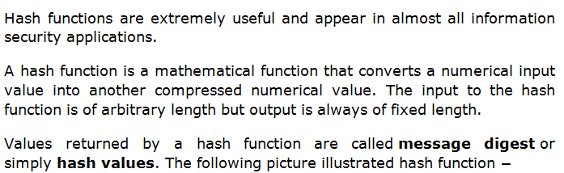
Hash Function

Slide 3
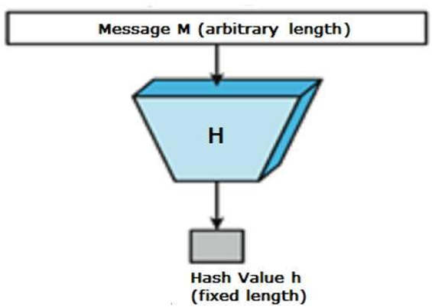

Slide 4
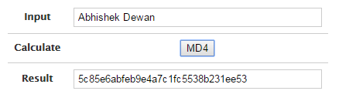
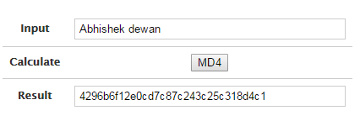
Example of real world hash value or message digest

Slide 5
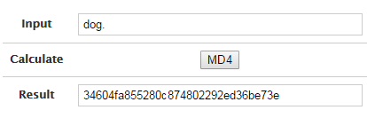
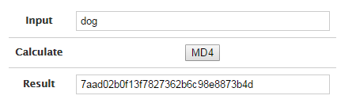

Slide 6
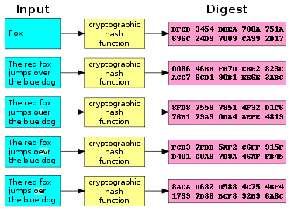

Slide 7
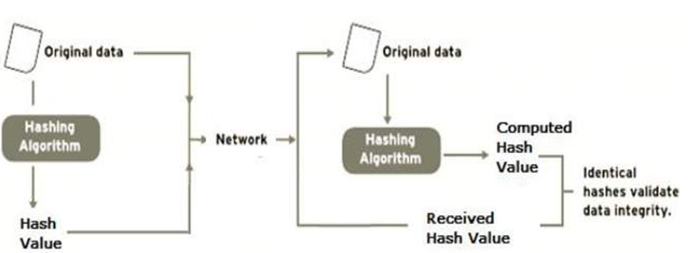
Working of hash

Slide 8
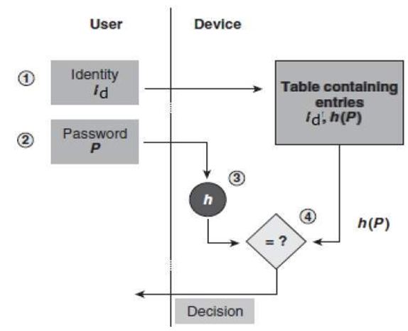
Working of hash function during log in procedure

Slide 9
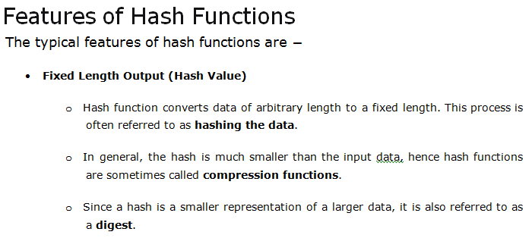

Slide 10
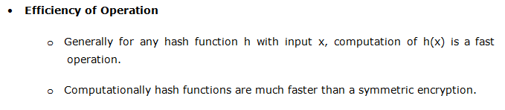

Slide 11
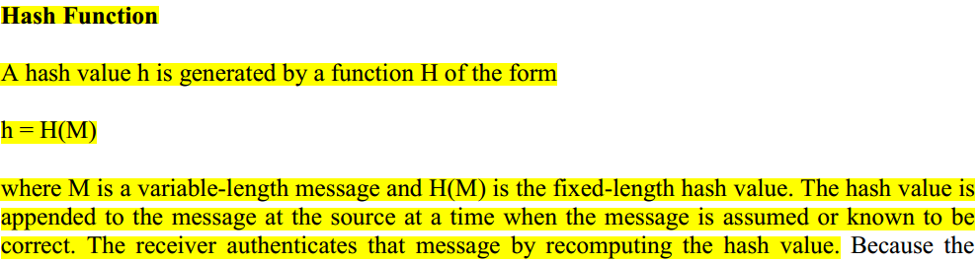
Hash Function

Slide 12
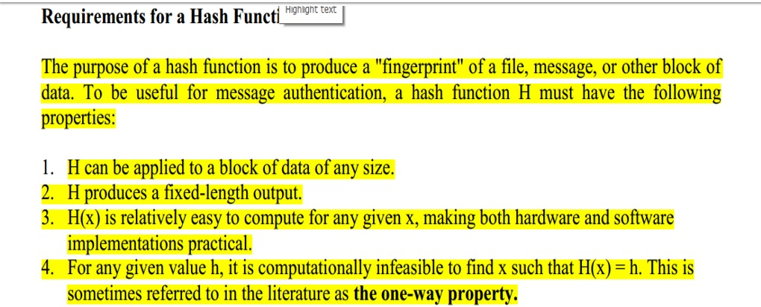

Slide 13
Given an arbitrary message m1m1, weak collision resistance implies that it is difficult to produce another message m2m2 such that H(m1)=H(m2)H(m1)=H(m2).

Slide 15
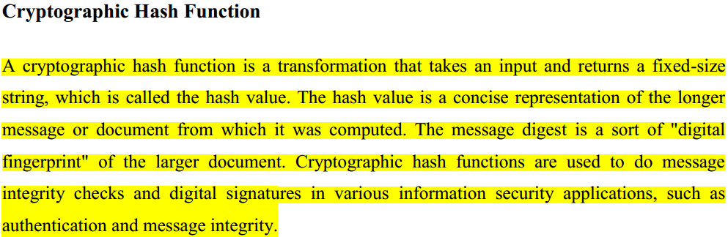

Slide 16
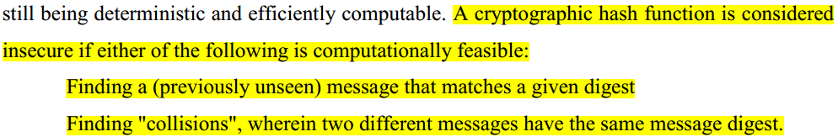
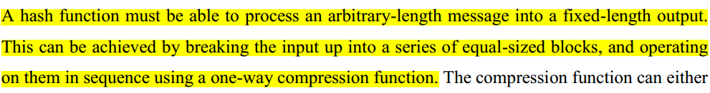

Slide 17
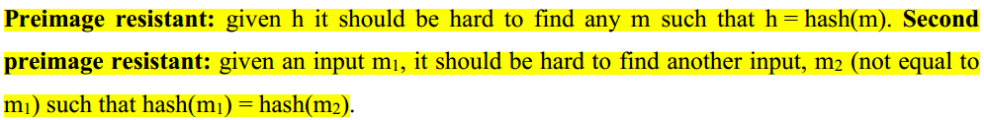
Prerequisites of Hash (TU)

Slide 18
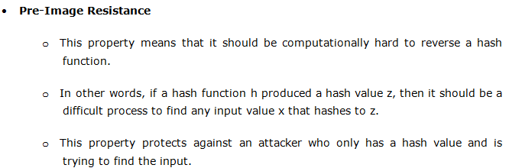
Once again Prerequisites,

Slide 19
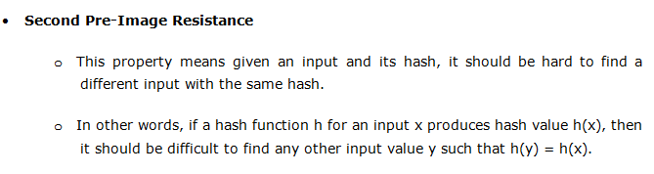


Slide 20
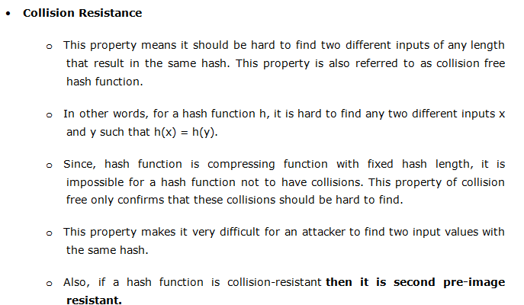

Slide 21
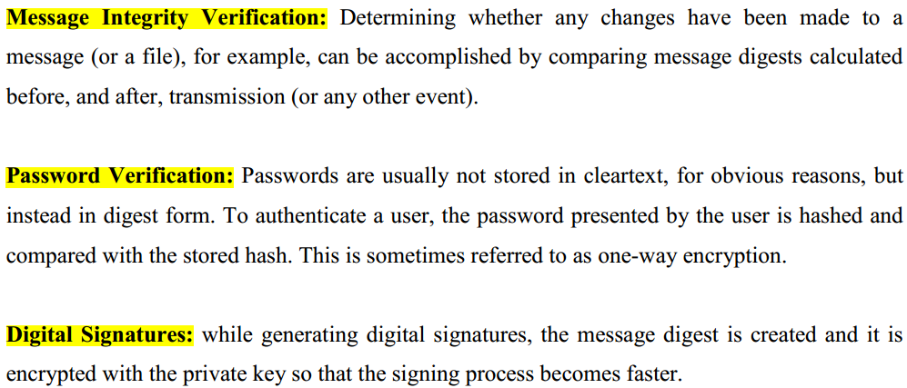
Applications of hash

Slide 22
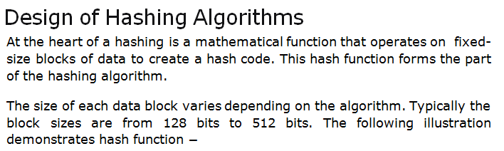
Design of Hashing Algorithm

Slide 23
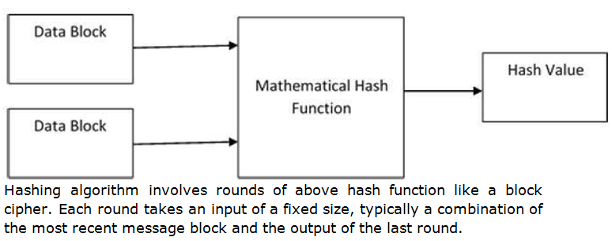

Slide 24
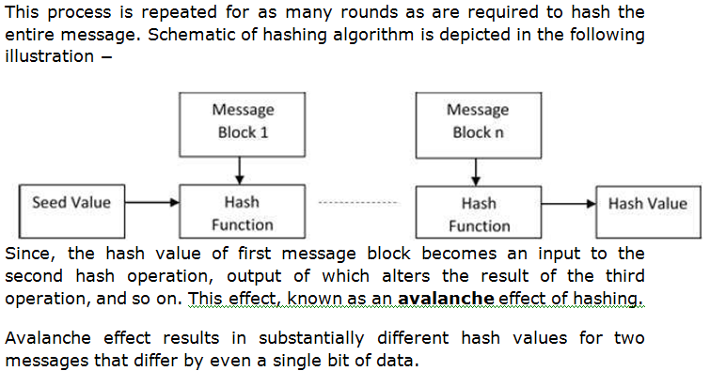

Slide 25
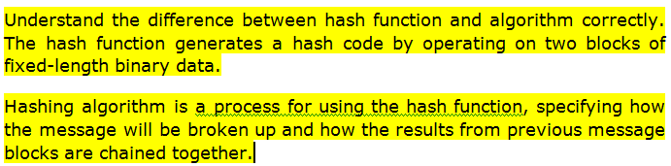
Hashing function and Hashing Algorithm

Slide 26
Some Popular Hash Functions
Message Digest(MD)
Example: MD4 and MD5
Secure Hash Algorithm (SHA) or Secure Hash Function.
Example: SHA-1, SHA-2

Slide 27
MD4 Algorithm
The MD4 (message-digest algorithm) hashing algorithm is a one-way cryptographic function that accepts a message of any length as input and returns as output a fixed-length digest value.
Ronald Rivest, founder of RSA Data Security LLC and professor at Massachusetts Institute of Technology, designed MD4 in 1990.

Slide 28
The MD4 message-digest hashing algorithm processes data in 512-bit strings, broken down into 16 words composed of 32 bits each.
The algorithm takes as input a message of arbitrary length and produces as output a 128-bit.

Slide 29
Throughout the Algorithm,
Let the symbol "+" denote addition of words (i.e., modulo 2^32 addition).
Let X <<< s denote the 32-bit value obtained by circularly shifting (rotating) X left by s bit positions.

Slide 30
Let not(X) denote the bit-wise complement of X, and let X v Y denote the bit-wise OR of X and Y.
Let X xor Y denote the bit-wise XOR of X and Y, and,
Let XY denote the bit-wise AND of X and Y.

Slide 31
Following the documentation, it consists of 5 steps that are as follow:
Append Padding bits
Append Length
Initialize MD buffer
Process the message in 16-Word blocks
Output

Slide 32
Example:
Converting the data to binary
When we put “They are deterministic” into an MD4 hash function, the first thing that happens is that it is converted to binary.
This is done according to the American Standard Code for Information Interchange (ASCII).

Slide 33
“They are deterministic” is written in binary as:
01010100 01101000 01100101 01111001 00100000 01100001 01110010 01100101 00100000 01100100 01100101 01110100 01100101 01110010 01101101 01101001 01101110 01101001 01110011 01110100 01101001 01100011

Slide 34
MD4 Step 1: Append Padding Bits
This step is very straightforward, extend the input message so its length in bits is congruent to 448 modulo 512.
we need to end up with a message which latest block’s length is 64 bits shy from 512 bits.
The padding pattern is as follow, a ‘1’ bit right after the message and then a series of ‘0’ to reach 448 modulo 512.

Slide 35
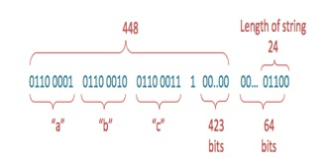

Slide 36
Suppose, 106 chars would represent 106 * 8 = 848 bits.
we need it to be congruent with 448 mod 512.
848 / 512 ≈1.65 means we have one full block of 512 bits here and almost 65% of a block.
848 % 512 = 336 bits the exact number of bits we fill inside the last block of 512.
Following this we need to feel 448–336 = 112 bits with our padding

Slide 37
MD4 Step 2: Append length of Message
Now fill the remaining 64 bits of the last block that will help us reach a perfect size of 512 bits by blocks for our input message.
Which is 106 bytes* 8 = 848 bits, so ‘848’ will be the value we will append at the end of the message within a 64 bits representation.
‘848’ translated into its binary form is 00000011 01010000

Slide 38
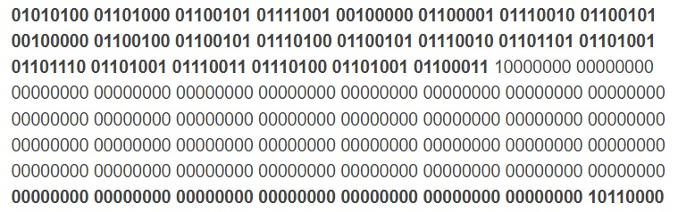
Step 1 & 2: Padding & adding length
Once the padding scheme is complete, we end up with the following 512-bit string:

Slide 39
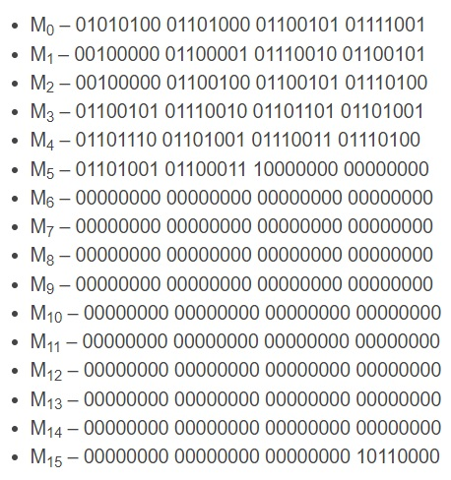
Our 512-bit M needs to be split into sixteen 32-bit “words”.

Slide 40

MD4 Step 3: Initialize MD Buffer
A four-word buffer (A,B,C,D) is used to compute the message digest. Here each of A, B, C, D is a 32-bit register.
These registers are initialized to the following values in hexadecimal:

Slide 41
MD4 Step 4: Process each 512 bit Block
In order to proceed, first define some auxiliary functions that will support the below computing operations.
The three following function takes 3 words as input and with some binary operations return 1 word.

Slide 42
In brief, the functions acts as below bitwise operators:
F: if X then Y else Z
G: if at least two of X, Y, Z then ‘1’ else ‘0’
H: X xor Y xor Z

Slide 43

Alternatively,

Slide 44
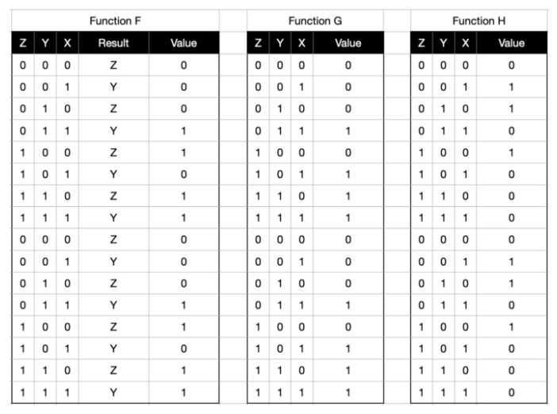

Slide 45
Save A as Aº, B as Bº, C as Cº, and D as Dº.
Aº = A
Bº = B
Cº = C
Dº = D

Slide 46
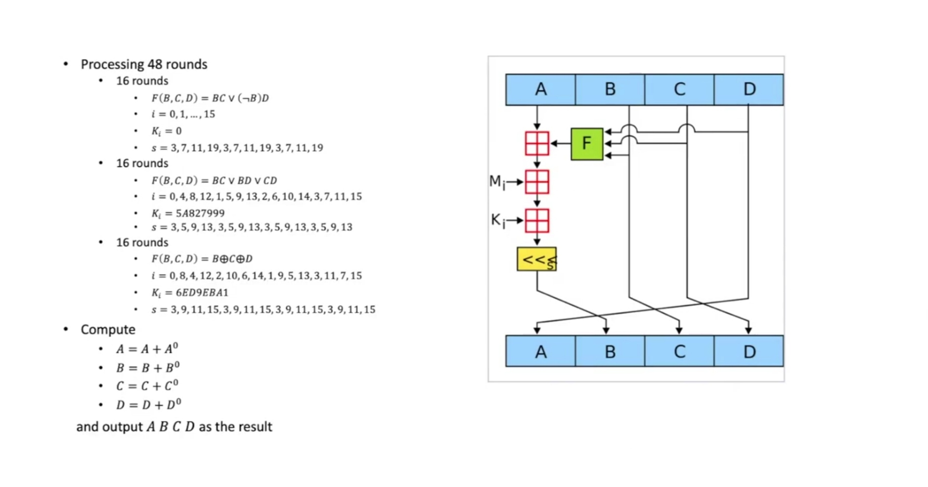

Slide 47
Modular addition
If you look at the arrow coming out of the F box, you will see that it points into another square that looks kind of like a window.
There’s also an arrow from the A going into this box.
The box symbol represents modular addition.
100000000 (this is the equivalent to 2³² (which ensures that the result of this equation are no more than eight characters long).

Slide 48
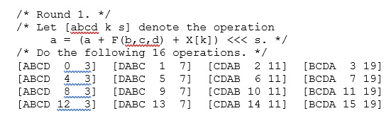
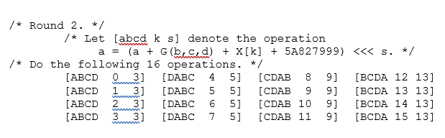
Detail Round Operations

Slide 49
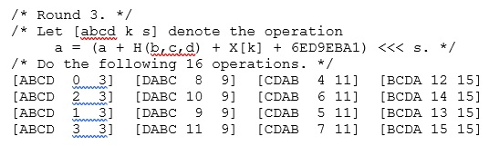

Slide 50
MD5 Algorithm
Ronald Rivest, founder of RSA Data Security LLC and professor at Massachusetts Institute of Technology, designed MD5 in 1991 as an improvement to a prior message-digest algorithm.
MD5 is the third message-digest algorithm Rivest created.
MD2, MD4 and MD5 have similar structures

Slide 51
The MD5 algorithm is an extension of MD4, which the critical review found to be fast.
The MD5 message-digest hashing algorithm processes data in 512-bit strings, broken down into 16 words composed of 32 bits each.
The output from MD5 is a 128-bit message-digest value.

Slide 52
Computation of the MD5 digest value is performed in separate stages that process each 512-bit block of data along with the value computed in the preceding stage.
The first stage begins with the message-digest values initialized using consecutive hexadecimal numerical values.

Slide 53
Each stage includes four message-digest passes, which manipulate values in the current data block and values processed from the previous block.
The final value computed from the last block becomes the MD5 digest for that block.

Slide 54
Following the documentation, it consists of 5 steps that are as follow:
Append Padding bits
Append Length
Initialize MD buffer
Process the message in 16-Word blocks
Output

Slide 55
Example:
Converting the data to binary
When we put “They are deterministic” into an MD5 hash function, the first thing that happens is that it is converted to binary.
This is done according to the American Standard Code for Information Interchange (ASCII).

Slide 56
“They are deterministic” is written in binary as:
01010100 01101000 01100101 01111001 00100000 01100001 01110010 01100101 00100000 01100100 01100101 01110100 01100101 01110010 01101101 01101001 01101110 01101001 01110011 01110100 01101001 01100011

Slide 57
Step 1 & 2: Padding & adding length
Once the padding scheme is complete, we end up with the following 512-bit string:

Slide 58
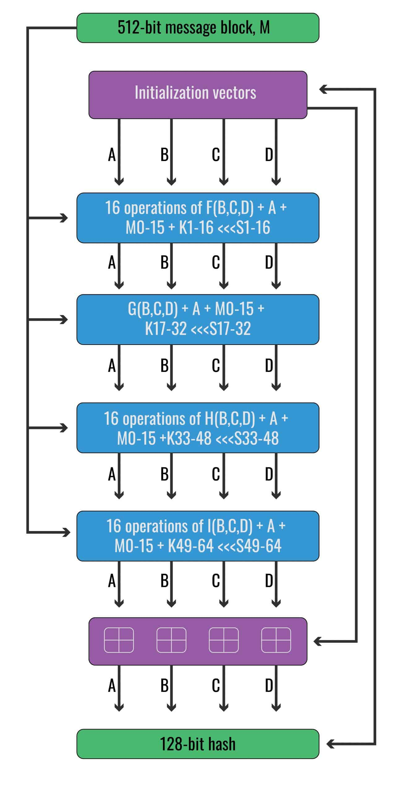

Slide 59
Our 512-bit M needs to be split into sixteen 32-bit “words”.

Slide 60
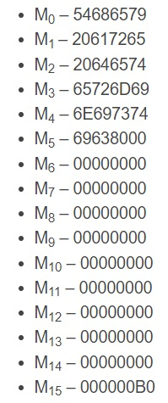
We will mostly be using hexadecimal:

Slide 61
In the first round, the M inputs are added into the algorithm sequentially,
M0, M1, M2… M15.
In the second round, the M inputs are added in the following order:
M1, M6, M11, M0, M5, M10, M15, M4, M9, M14, M3, M8, M13, M2, M7, M12

Slide 62
In the third round, the M inputs are added in this sequence:
M5, M8, M11, M14, M1, M4, M7, M10, M13, M0, M3, M6, M9, M12, M15, M2
In the fourth round, the M inputs are added in the following order:
M0, M7, M14, M5, M12, M3, M10, M1, M8, M15, M6, M13, M4, M11, M2, M9

Slide 63
Step 3: Initialize MD Buffer
The initialization buffers:

Slide 64
4 Auxiliary functions that will support the computing operations.
Round 1: F(b,c,d) = (b AND c) OR ((NOT b) AND (d))
Round 2: G(b,c,d)=(b AND d) OR (c AND (NOT d))
Round 3: H(b,c,d)=b XOR c XOR d
Round 4: I(b,c,d)=c XOR (b OR (NOT d))

Slide 65
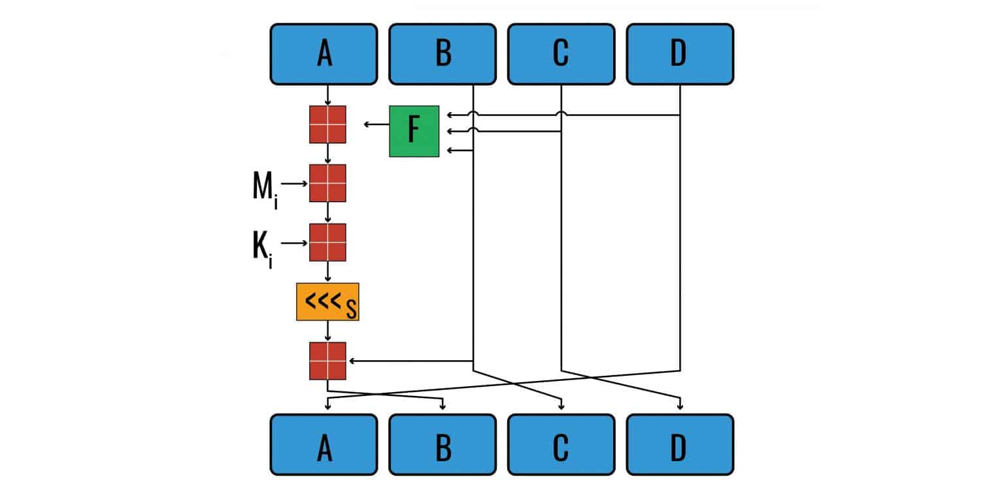
Step 4: Process each 512 bit Block

Slide 66
A constant, K, is added to the result, using the same special type of addition.
The values for K are derived from the formula:
abs(sin(i+ 1))×2³²

Slide 67
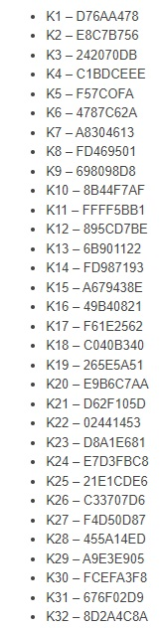
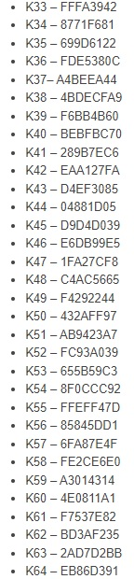

Slide 68
After the K value has been added, the next step is to shift the number of bits to the left by a predefined amount:

Slide 69
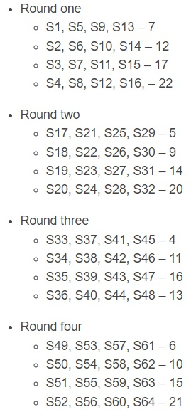

Slide 70
After the shift has been made, the result of all of these calculations is added to the value for initialization buffer B.
Initially, it’s 89abcdef, but it changes in subsequent operations.

Slide 71
The output of this value becomes the initialization vector for B in the next operation.
The initialization vectors B, C and D are shuffled over one space to the right, so that B becomes C, C becomes D, and D becomes A in the next operation.

Slide 72
Upon conclusion of the fourth round and its 64th operation, the outputs are added to the original initialization vectors.
The result of this calculation is the final MD5 hash of our input.

Slide 73
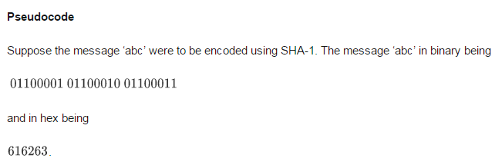
Working and Operations involved in SHA-1 (TU)

Slide 75
SHA-1 Algorithm
SHA-1 or Secure Hash Algorithm 1 is a cryptographic hash function which takes an input and produces a 160-bit (20-byte) hash value.
This hash value is known as a message digest.
This message digest is usually then rendered as a hexadecimal number which is 40 digits long.

Slide 76
It is a U.S. Federal Information Processing Standard and was designed by the United States National Security Agency in 1993.
SHA-1 is now considered insecure since 2005.
Major tech giant browsers like Microsoft, Google, Apple and Mozilla have stopped accepting SHA-1.

Slide 77
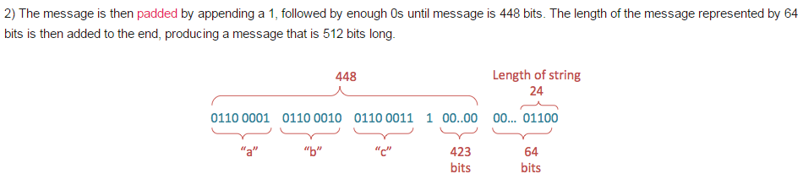

Slide 78

Since, 16 x 32 = 512 bits

Slide 79
Step 3: Prepare Processing Functions….
SHA1 requires 80 processing functions defined as:
f(t;B,C,D) = (B AND C) OR ((NOT B) AND D) ( 0 <= t <= 19)
f(t;B,C,D) = B XOR C XOR D (20 <= t <= 39)
f(t;B,C,D) = (B AND C) OR (B AND D) OR (C AND D) (40 <= t<=59)
f(t;B,C,D) = B XOR C XOR D (60 <= t <= 79)
Step 4: Prepare Processing Constants....
SHA1 requires 80 processing constant words defined as:
K(t) = 5A827999 ( 0 <= t <= 19)
K(t) = 6ED9EBA1 (20 <= t <= 39)
K(t) = 8F1BBCDC (40 <= t <= 59)
K(t) = CA62C1D6 (60 <= t <= 79)

Slide 80
Step 5: Initialize Buffers….
SHA1 requires 160 bits or 5 buffers of words (32 bits):
H0 = 67452301
H1 = EFCDAB89
H2 = 98BADCFE
H3 = 10325476
H4 = C3D2E1F0

Slide 81
Step 6: Processing Message in 512-bit blocks (L blocks in total message)….
This is the main task of SHA1 algorithm which loops through the padded and appended message in 512-bit blocks.
Input and predefined functions:
M[1, 2, ..., L]: Blocks of the padded and appended message
f(0;B,C,D), f(1,B,C,D), ..., f(79,B,C,D): 80 Processing Functions
K(0), K(1), ..., K(79): 80 Processing Constant Words
H0, H1, H2, H3, H4, H5: 5 Word buffers with initial values

Slide 82
Step 6: Pseudo Code….
For loop on k = 1 to L
(W(0),W(1),...,W(15)) = M[k] /* Divide M[k] into 16 words */
For t = 16 to 79 do:
W(t) = (W(t-3) XOR W(t-8) XOR W(t-14) XOR W(t-16)) <<< 1
A = H0, B = H1, C = H2, D = H3, E = H4
For t = 0 to 79 do:
TEMP = A<<<5 + f(t;B,C,D) + E + W(t) + K(t)
E = D, D = C, C = B<<<30, B = A, A = TEMP
End of for loop
H0 = H0 + A, H1 = H1 + B, H2 = H2 + C, H3 = H3 + D, H4 = H4 + E
End of for loop
Output:
H0, H1, H2, H3, H4, H5: Word buffers with final message digest

Slide 83
SHA processing in detail

Slide 84
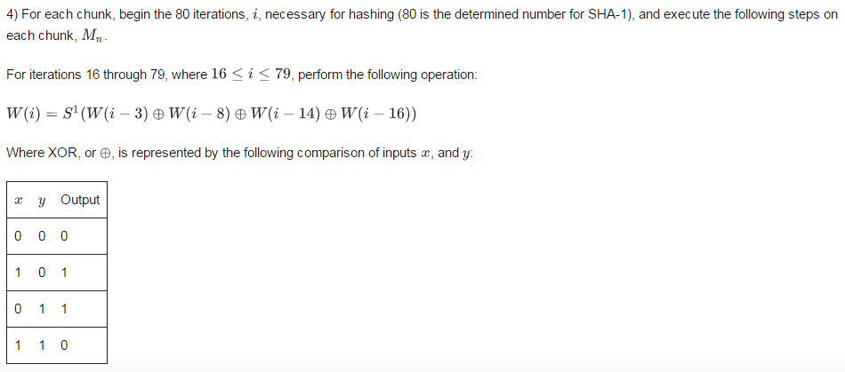

Slide 85
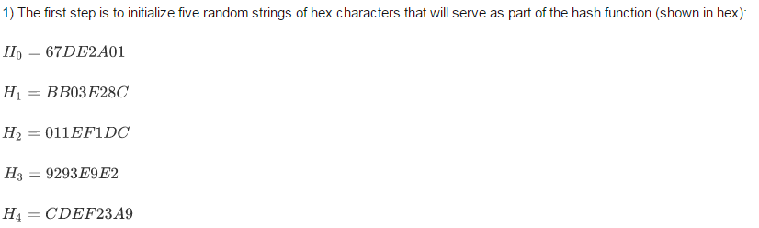

Slide 86
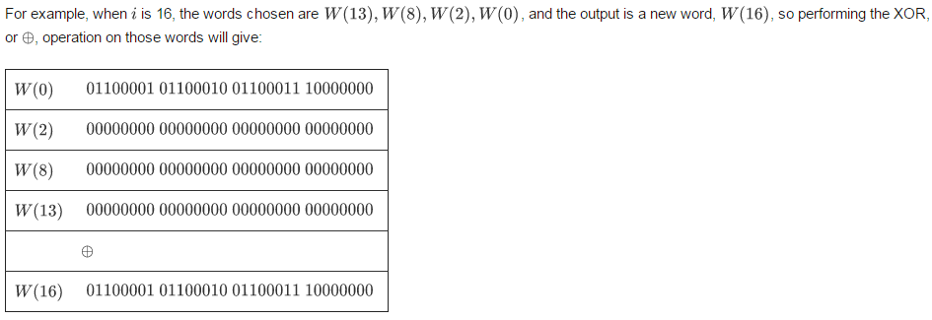

Slide 87
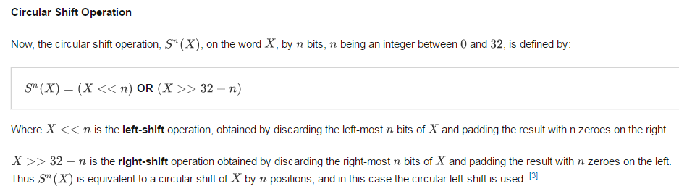

Slide 88
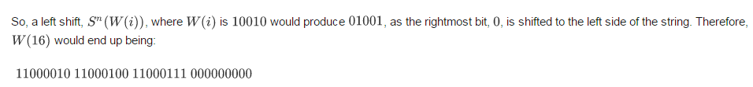

Slide 89
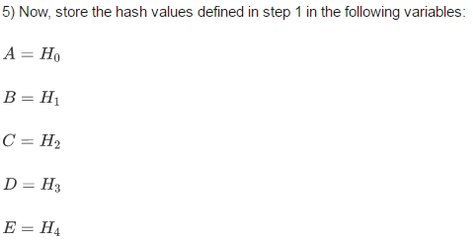

Slide 90
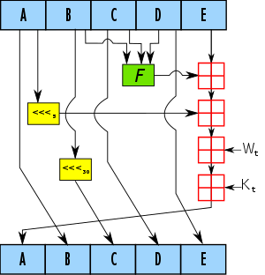

Slide 91

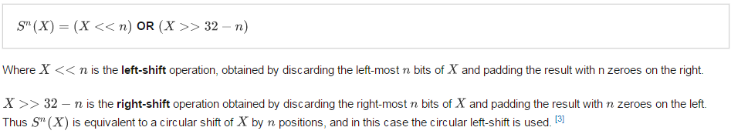
NOTE: here, S5*A means circular shift operation on A by 5 bits on the basis of:

Slide 92
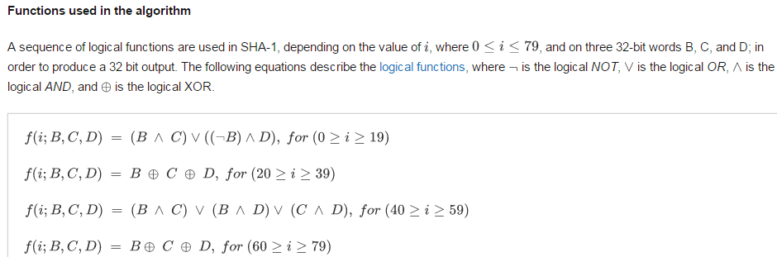
Functions used in SHA-1

Slide 93

Constants used in SHA-1

Slide 94


Slide 95


Slide 96


Slide 97
SHA-2 Algorithm
Due to the exposed vulnerabilities of SHA-1, cryptographers modified the algorithm to produce SHA-2, which consists of not one but two hash functions known as SHA-256 and SHA-512, using 32- and 64-bit words, respectively.
There are additional truncated versions of these hash functions, known as SHA-224, SHA-384, SHA-512/224, and SHA-512/256, which can be used for either part of the algorithm.

Slide 98
The SHA-256 algorithm is one flavor of SHA-2 (Secure Hash Algorithm 2), which was created by the National Security Agency in 2001 as a successor to SHA-1.

Slide 99
SHA-1 and SHA-2 differ in several ways; mainly, SHA-2 produces 224- or 256-sized digests, whereas SHA-1 produces a 160-bit digest;
SHA-2 can also have block sizes that contain 1024 bits, or 512 bits, like SHA-1.
Brute force attacks on SHA-2 are not as effective as they are against SHA-1.

Slide 100
A brute force search for finding a message that corresponds to a given digest of length L using brute force would require 2^{L} evaluations, which makes SHA-2 a lot safer against these kinds of attacks.

Slide 101
Steps in SHA-256:
Append Padding bits and length like before.

Slide 102

Initialize Buffers:

Slide 103


Initialize constants:

Slide 104

Copy the input data from step 1 into a new array where each entry is a 32-bit word:

Slide 105

Add 48 more words initialized to zero, such that we have an array w[0…63]

Slide 106
Perform the following:
For i from w[16…63]:
s0 = (w[i-15] RightRotate 7) xor (w[i-15] RightRotate 18) xor (w[i-15] rightshift 3)
s1 = (w[i- 2] RightRotate 17) xor (w[i- 2] RightRotate 19) xor (w[i- 2] rightshift 10)
w[i] = w[i-16] + s0 + w[i-7] + s1

Slide 107


Slide 108
In the above,
X >> n is obtained as follows:
the right-most n bits of X are discarded and then the results is padded with n zeros on the left.
X << 32-n is obtained by discarding the n left-most bits and then padding the result with n zeros on the right.

Slide 109

Perform Compression:

Slide 110

Modify Final Values:
Append all the obtained hash.

Slide 111
SHA-512 Algorithm
The entire formatted message has basically three parts: the original message, padding bits, size of original message.
The formatted message will be processed as blocks of 1024 bits each, so each bock should have 1024 bits to work with.
This size value needs to be represented in 128 bits.
SHA-512 has an output size of 512 bits.

Slide 112
Hashing Algorithm — SHA-512
These stages go as follows:
Input formatting
Hash buffer initialization
Message Processing
Output

Slide 113
End of Unit ‘4’

